Slide 1
Zomato Order Data Analysis
By Debasish Bora

Slide 2
Introduction
Hello everyone,
I am Debasish Bora, an aspiring data analyst, and I am excited to share my recent project where I analyzed my personal Zomato order data. I analyzed my order history using Excel and SQL to better understand my ordering patterns, spending habits, and food preferences. The main objective of this analysis is to uncover insights into how frequently I order, the amount of money spend each month on online food ordering, and my favorite food items. By examining this data, I aim to make more informed decisions about my future orders and manage my expenditures better. Let's dive into the findings and explore the trends in my Zomato orders.

Slide 3
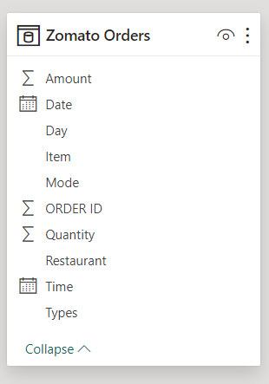
Dataset Outline
The dataset used for this analysis comprises detailed records of my personal Zomato orders. Each record captures various aspects of an order, structured into the following fields:
ORDER ID: A special number assigned to each order which makes it easier to clearly identify each transaction.
DATE: The specific date when the order was placed.
Time: The exact time the order was placed.
Item: The names of the items ordered.
Quantity: The number of each item ordered.
Amount: The total cost of the order.
Restaurant: The name of the restaurant from which the order was placed.
Mode: The mode of payment used for the order, with options including UPI, Simpl Wallet, Cash, and Debit Card.
Day: The day of the week the order was placed.

Slide 4
Purpose of the Analysis
The analysis aims to achieve the following objectives:
Determine the total number of orders placed over the given period.
Calculate the total amount of money spent on online food delivery during the analysis period.
To determine spending trends per order, by computing average order value.
Identify the top 10 restaurants from which orders were most frequently placed.
Identify the top 10 food items that were ordered most frequently.
Determine the most preferred mode of payment among UPI, Simpl Wallet, Cash, and Debit Card.
Analyze the number of orders placed per day.
Determine the most preferred food items on weekends.
Calculate the average amount of money spent per day
Analyze the number of orders placed hourly to identify peak ordering hours.
Determine the number of vegetarian and non-vegetarian items ordered.
Total expenditure on vegetarian and non-vegetarian items.
Determine the restaurants where the highest expenditure was incurred.
Identify the top 10 days with the highest total expenditure.

Slide 5
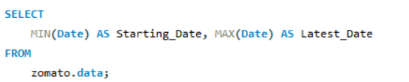

Time period of the Dataset
Query
Output

Slide 6
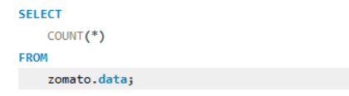

Total number of orders
Query
Output

Slide 7
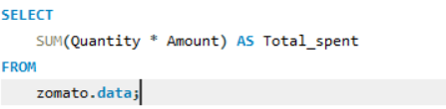

Total amount spent
Query
Output

Slide 8
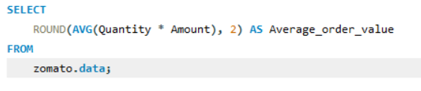

Average order value
Query
Output

Slide 9
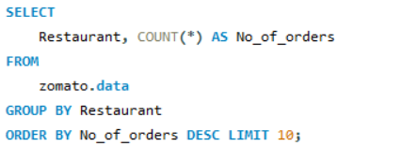
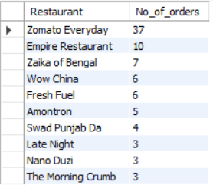
10 mostly ordered restaurants
Query
Output

Slide 10
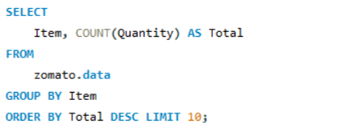
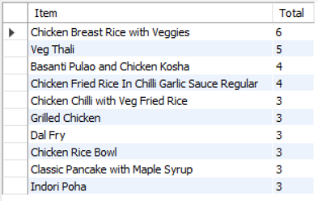
Top 10 mostly ordered food items
Query
Output

Slide 11
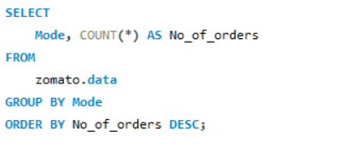
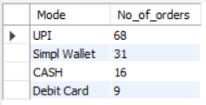
Most preferred mode of payment
Query
Output

Slide 12
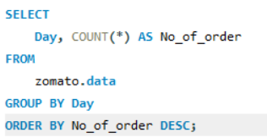
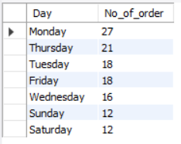
Orders by Day of the week
Query
Output

Slide 13
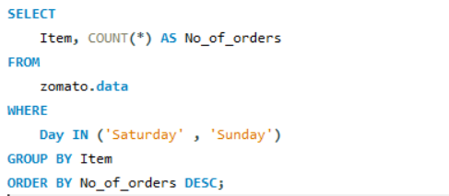
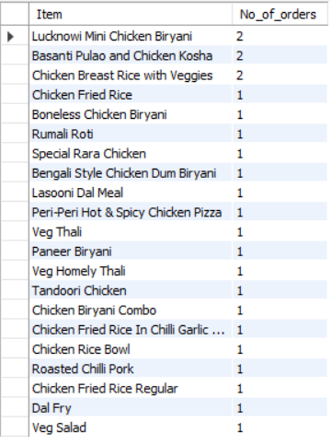
Most preferred items on weekends
Query
Output

Slide 14
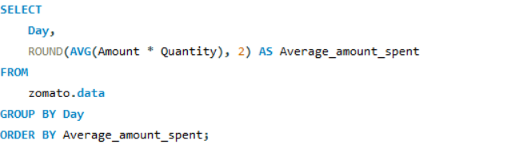
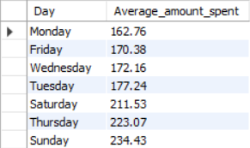
Average money spent per day
Query
Output

Slide 15
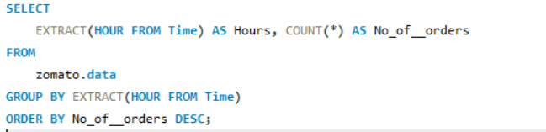
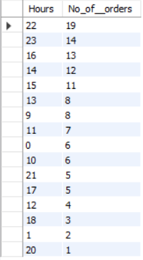
No of orders hourly
Query
Output

Slide 16
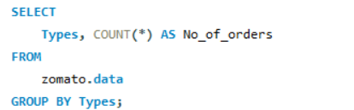

Total veg and non-veg item ordered
Query
Output

Slide 17
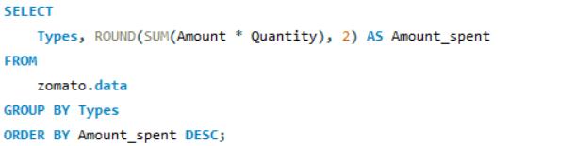

Total exapenditure on veg and non-veg items
Query
Output

Slide 18
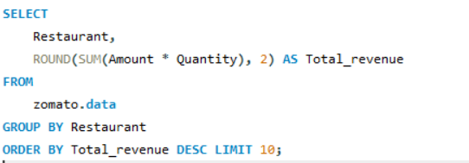
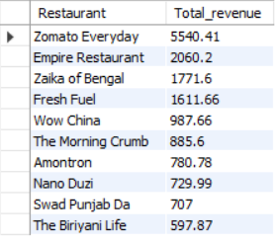
Most Money spent on each restaurant
Query
Output

Slide 19
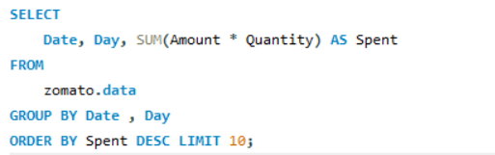
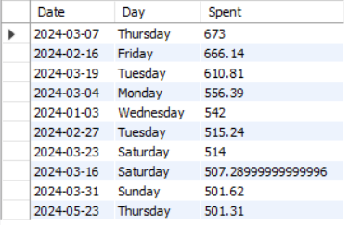
Top 10 days with highest spends
Query
Output

Slide 20
Thank You

